Slide 1


Slide 2
SupportICUs app design
(phone & tablet)
walkthrough

Slide 3
FIGMA designs
TABLET light theme design:
https://www.figma.com/file/4i6n2tJIVQPW6GO2JOOu3S/supportICUs-light-theme-(tablet)?node-id=0%3A1
PHONE dark theme design:
https://www.figma.com/proto/AFBAQEbkz8kfAzBFhs3Der/supportICUS?node-id=0%3A1&scaling=min-zoom&page-id=0%3A1&starting-point-node-id=13%3A20

Slide 4
Is app design art?

Slide 5
YES!
App design is a combination of UI and UX design to build out a usable piece of software. Organizing app capabilities and methods, blending colors, shapes, icons, images and even simple lines; all work together in order to get a message across and create a calm digital environment for the stressful ICU workplace.
It also consists of elements of other design methods, such as:
Graphic design
Web design

Slide 6
Our design principles
The goal is for our design to be:
User friendly
Simple-to the point
Functional-easy to use
Aesthetically pleasing
Uplifting-calming-optimistic

Slide 7
Disclaimer
The effectiveness and the aesthetics of our design are to be judged by the reader and the future users of the app. So, in the following slides we are going to present a walkthrough of our ideas and inspirations, explaining key details.

Slide 8

App Icon
This is the icon of our app. The colors were chosen to be comforting and are used throughout the whole app. The dark blue at the top is used in the dark theme, while the lighter blue in the middle is used in the light theme. The name was chosen to be catchy, as it can be read similarly to ‘Spartacus’. Also, it was chosen to be to the point, because it supports ICUs in many ways and areas. For example, ‘eICU’ is not a broad enough name, as it refers to a different kind of applications.

Slide 9
TABLET Light theme

Slide 10

Initial Screen
The loading screen was chosen to be the one on the right, because it encapsulates the multi-dimensionality of the app, being both a clinical decision support system and a data analytics platform and aiding both in the patients’ and in the ICU’s organization. Also, it extends the color continuity of the chosen main colors.

Slide 11
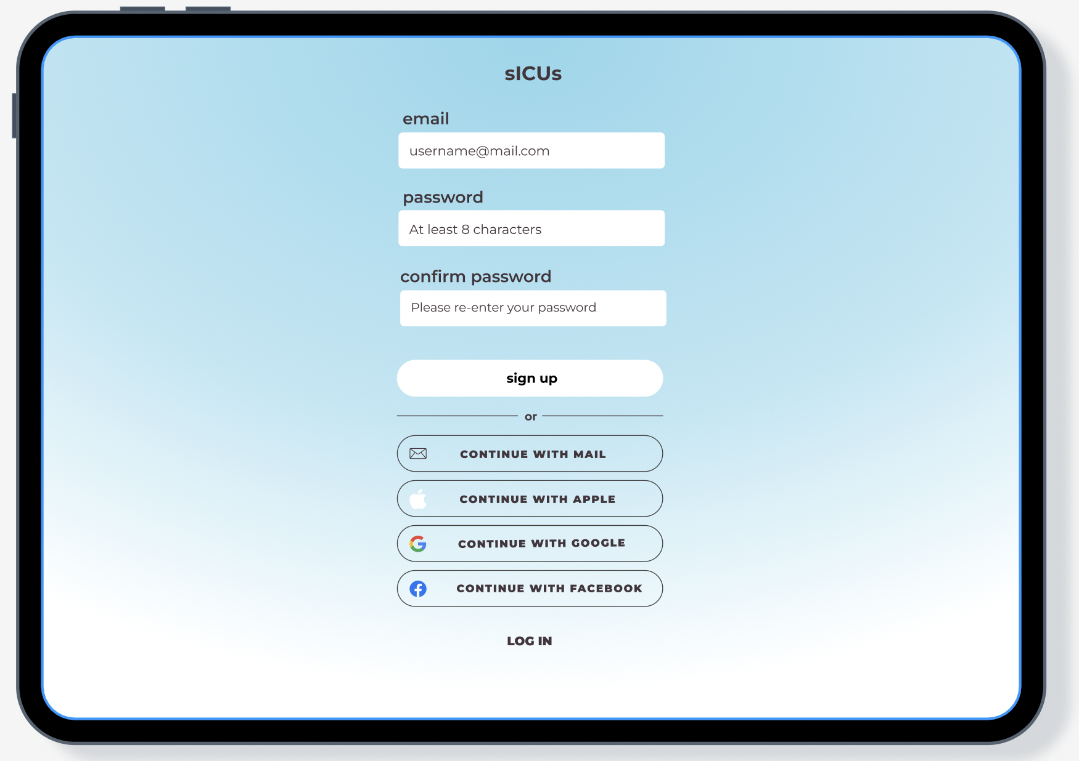
Sign in/up Screen
This screen is –of course- essential. Rather than being quite boring, we chose the radial gradient technique for a more playful color design, that will make the user more eager to continue (we tried to make a calming/optimistic color combination). Also, the radial gradient separates the sign up with the login options.

Slide 12
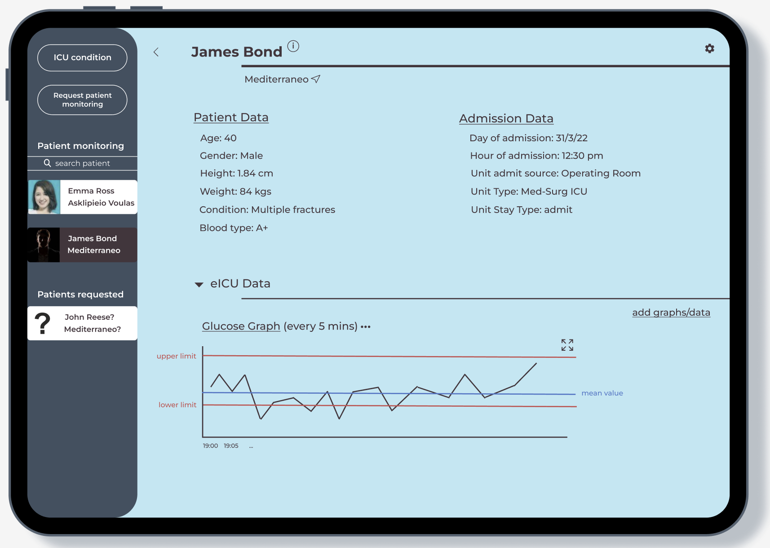
Main Screen
Of course, the color continuity is also extended by the main screen. The rest of the colors were chosen with the aim to blend in with the main light blue. One thing to note is that the letters are not black but rather a combination of brown and dark red, same as the one used for the frame of the patient ‘James Bond’ (selected frame).
On the left we have a static oval section that help us avoid navigating through many windows; there are organized options only there that can change window! Therefore, the design is very simplistic and going through a window and then through another and another etc., is avoided. Also, returning to a previous window is simple, implemented by the backwards arrow.
Finally, the data are organized in different conceivable blocks. The main titles are emphasized by the lines that reach the right side and can be minimized via the arrow next to the title (same way as google colab).

Slide 13
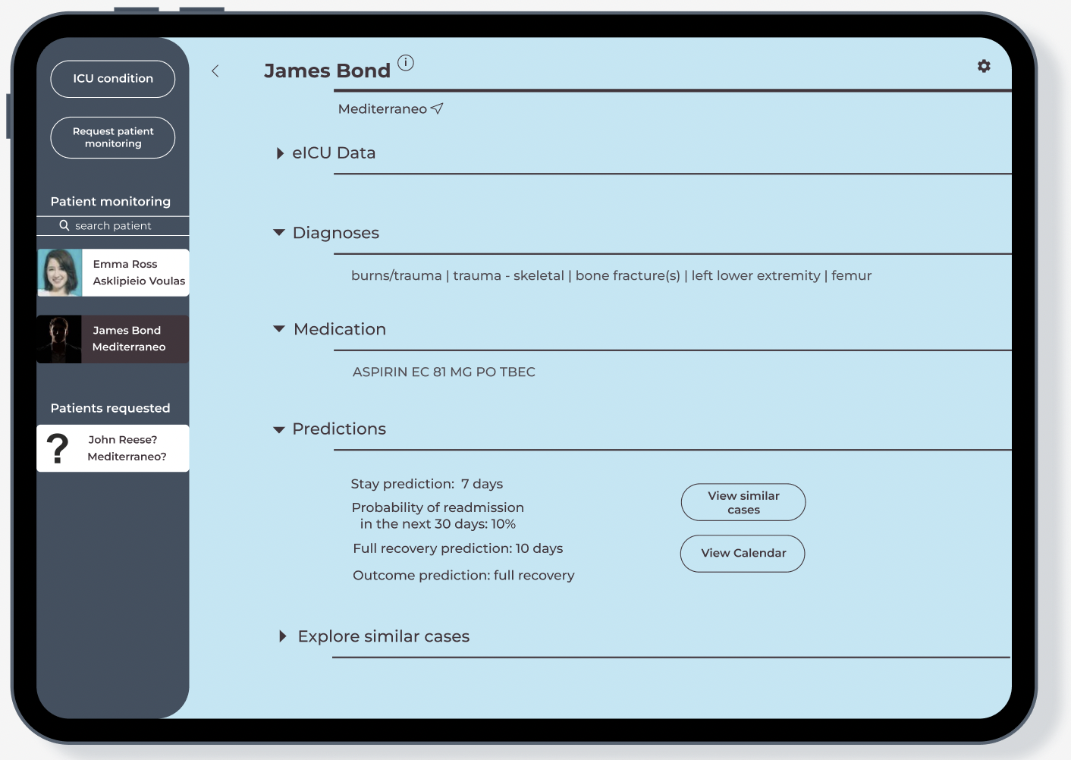
Main Screen II
Here one can see how the titles are organized and the importance of minimizing data that is unnecessary at the moment (e.g. ‘eICU data’).
Speaking of titles, the name of the patient is the main title and so the letters and corresponding line are more obvious than the rest of the titles. Under the line of a title, additional info is provided. For a patient, we have their corresponding hospital and the location icon right next to it. The rest of the lines are used to mark the position of titles and therefore the one of a new section.

Slide 14
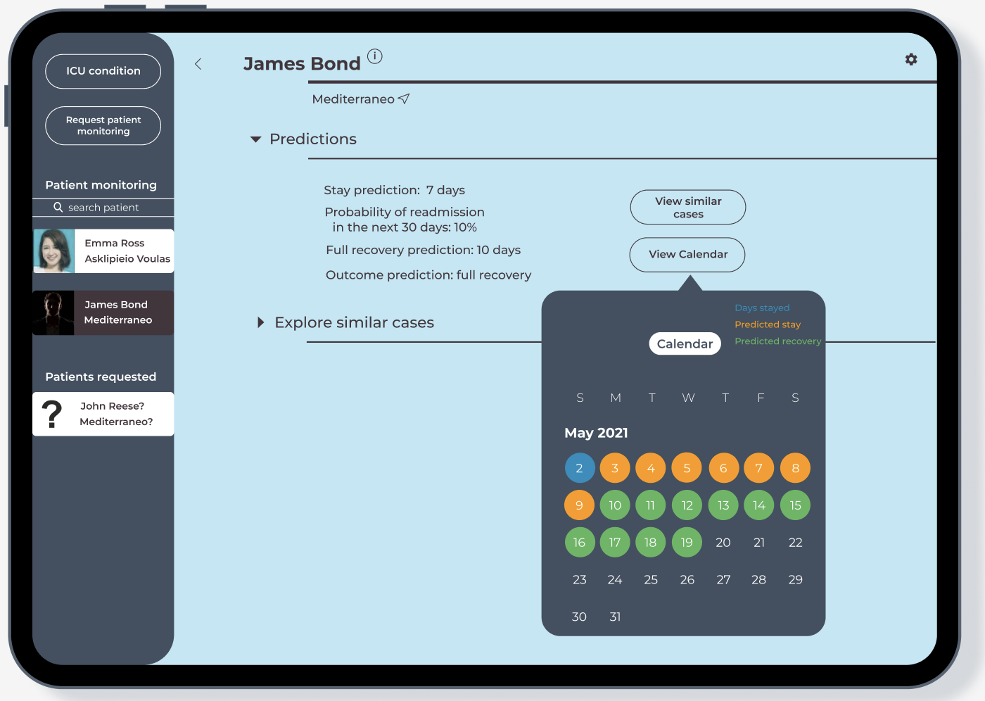
Main Screen III
‘View calendar’ opens a new little window with colors visualizing what is expected to happen in each day. The color of the frame is the same as the main oval frame on the left.

Slide 15
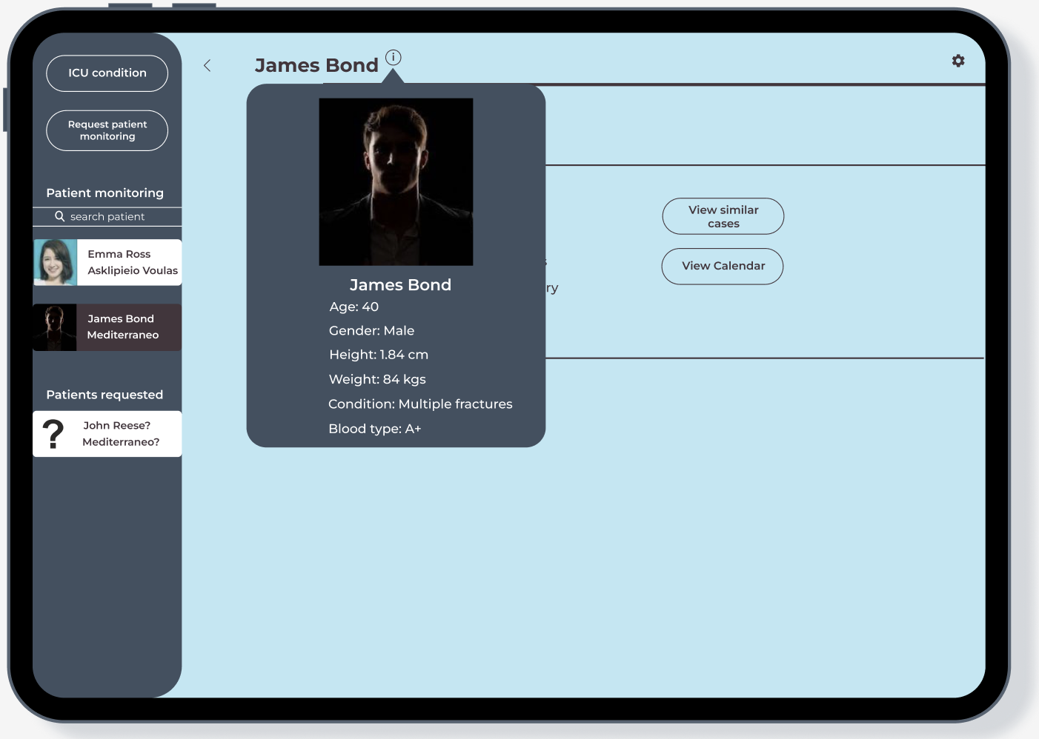
Main Screen IV
Same with the ‘i’ icon next to the main/patient’s title. It is used to display the picture in a bigger format, without disrupting the continuity and purpose of the main screen.

Slide 16
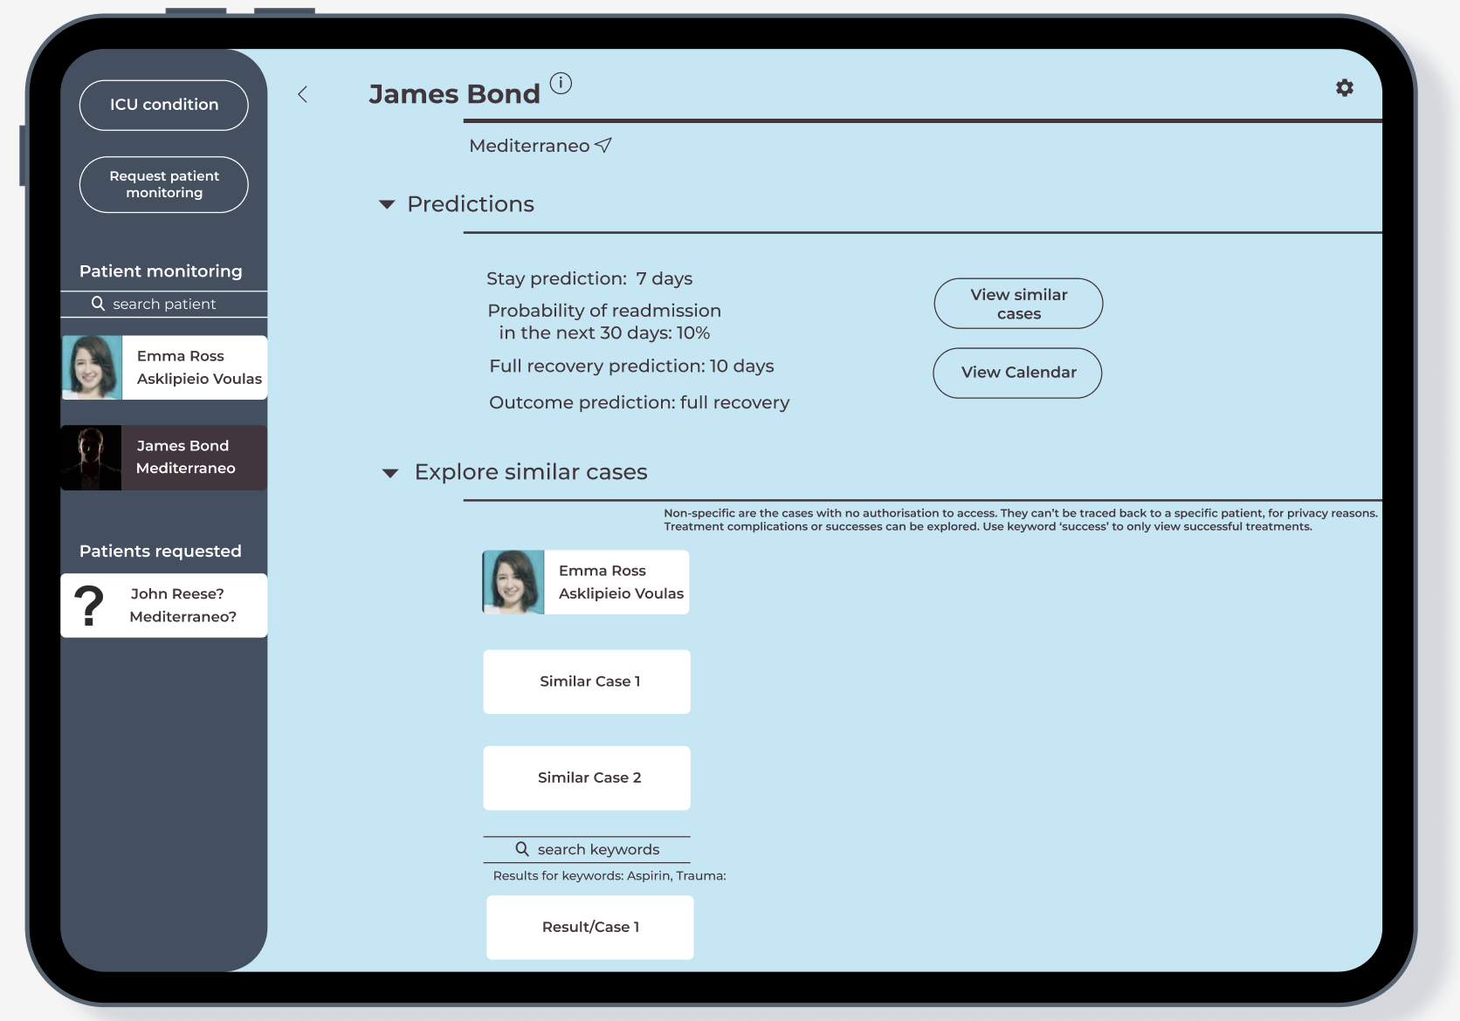
Main Screen V
Finally, the similar cases are presented in the same way as in the main oval menu/section on the left. Note here that the cases that cannot be accessed by the doctor are referred to as similar cases and the data provided cannot be traced back to a specific patient.

Slide 17
Phone Dark theme

Slide 18
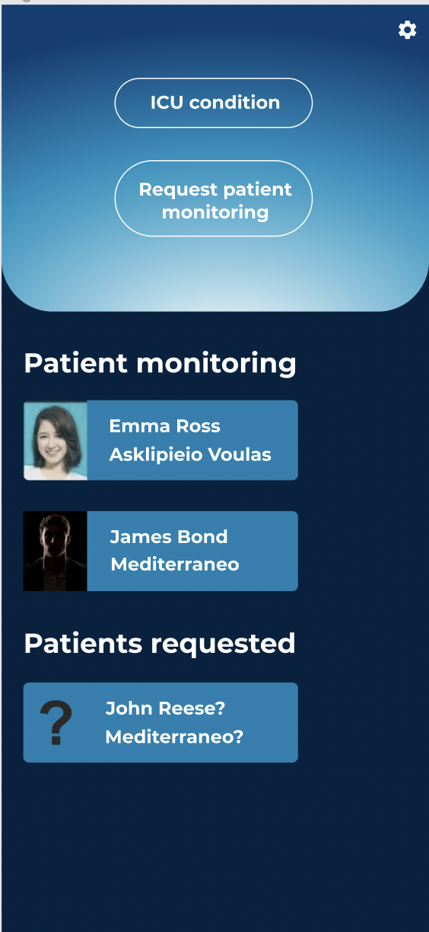

Main Screen
In the phone app, the main oval section of the tablet app is the main screen. So, anyone who wants to navigate through the main functionalities of the app must return to the main screen. The main buttons (ICU condition, Request patient monitoring) continue to be the same for the sake of continuity. Only the frames of the patients change color but not shape, because we are now in the dark them!

Slide 19
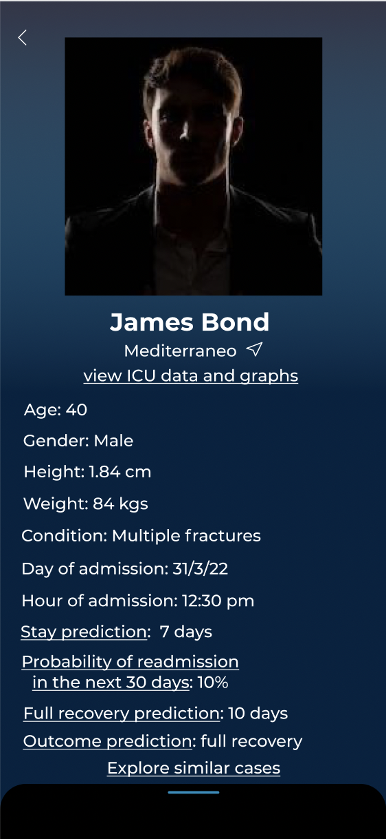
Patient Screen
I
This Is the patient screen. We have their picture, their name, their hospital and the patient and admission data, followed by the predictions about the patient. Pressing underlined text brings you the corresponding new screen. The navigation through the screens was carefully thought of, in order to make sense, group data logically and avoid many new screens.
Pressing ‘view ICU data and graphs’ brings a key functionality: presenting eICU data for telemedicine purposes or just being a point of reference for all data with statistics, diagrams and history. As it is a key feature, we dedicated a new screen for it.
Pressing one of the predictions shows the similar cases related to it, that serves as validation for the prediction.
Finally, exploring ‘similar cases’ shows cases that might be useful for the doctor about implications of certain diseases/medicine and allows the doctor to explore similar cases based on keywords.

Slide 20
Patient Screen
II
So, the predictions were grouped together with the ‘exploration of similar cases’, because they all lead to a similar window of older cases. The colors here and everywhere in the dark theme in the app were chosen not to be too depressing or dark, but rather remind of dusk (the light theme was chosen to remind the blue sky). Also, there is a playful tone in the background; the radiant gradient behind James Bond’s picture.

Slide 21
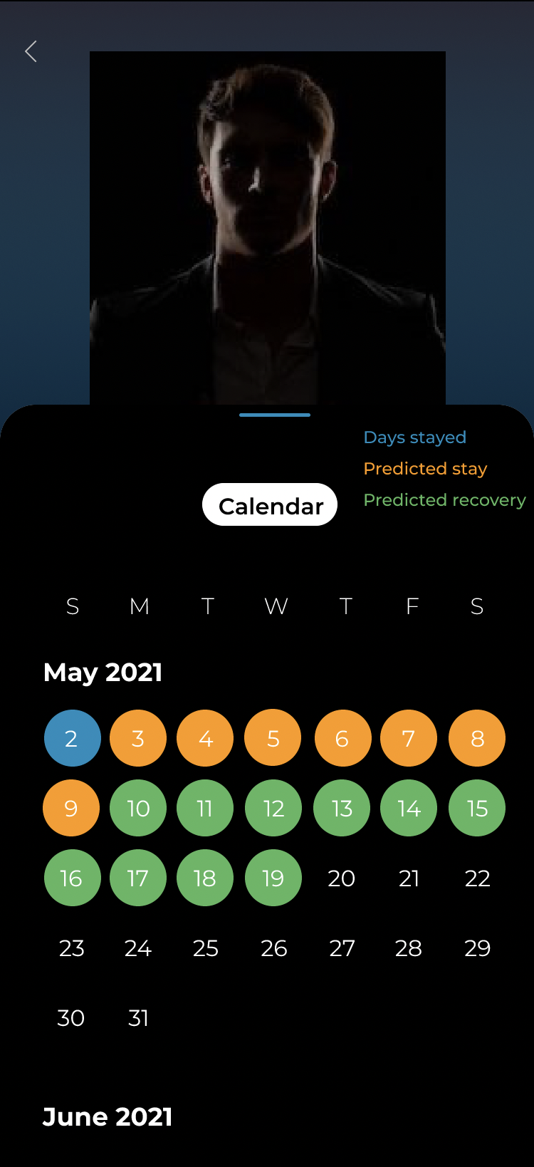
Patient Screen
III
By swiping upwards someone can see the visualization of the predictions, showing how many days has the patient stayed, how many they are expected to stay and how many they will need to recover.

Slide 22
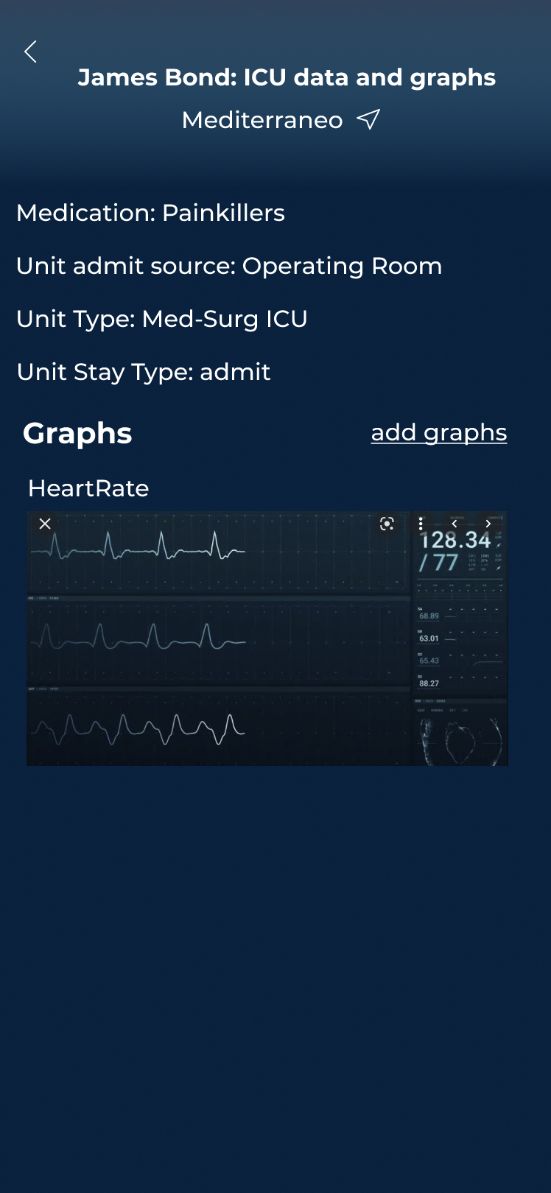
eICU
data screen
By pressing the ‘view ICU data and graphs’ button we get to the corresponding screen. Here, we can see key data, digitalizing patient’s monitoring in this key screen. Graphs can be added or be hidden. They can also be selected to be maximized and minimized.

Slide 23
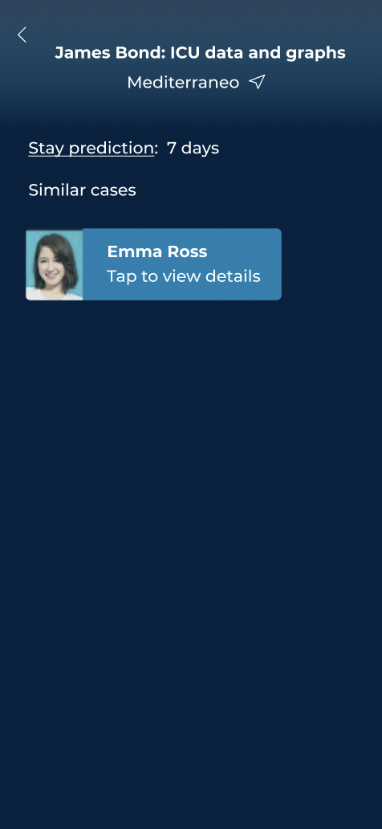
Similar Cases
data screen
The similar cases screen contains the prediction that is related to it. The cases are presented in the same way as in the main screen.

Slide 24
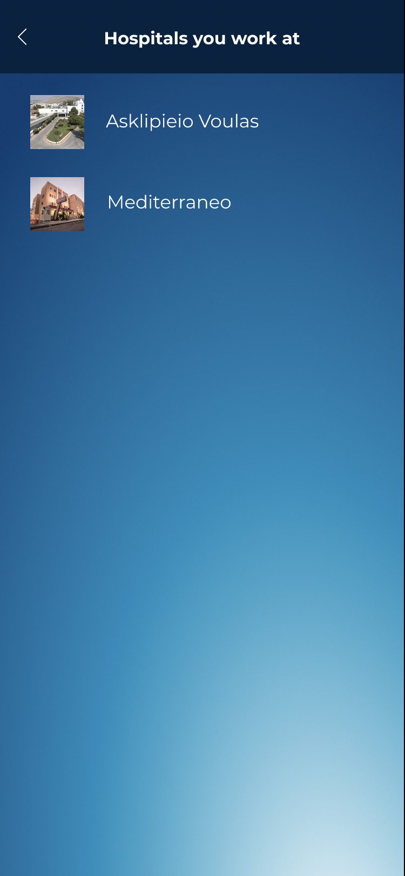
ICU condition screen
Choosing to see the ICU condition redirects to a page where someone must first select the hospital, they are working in. Here is evident our favorite technique of gradient radiant, for a playful tone.

Slide 25
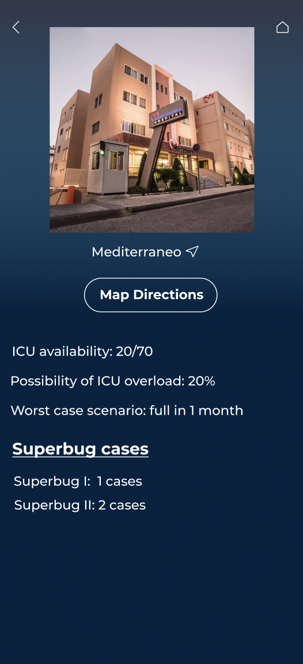
ICU condition screen II
Here we monitor the ICU beds, the superbugs and the equipment. The design methods have already been discussed in previous screens, check if you can spot them!

Slide 26
The End

